Slide 1
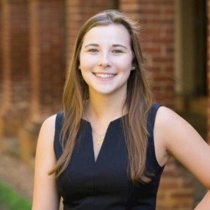
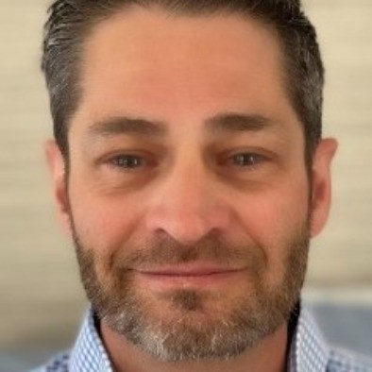
ECONOMICS
CAREER OFFICE
Putting an Economics Degree to Work Globally
A Career Panel
Friday, October 25 | Monroe Hall, 120
Panel: 11:00 am – 12:00 pm Luncheon: 12:15 pm – 1:15 pm
Moderated by Helen Hwang
Cameron Haddad
Economics ‘19
Consultant,
The World Bank
Catherine Griesedieck
Economics ‘18
Infectious Disease Project Manager, USAID
Chris Perine
Economics ‘87
Managing Director Climate Group, Chemonics International
Register for the panel here:
https://virginia.joinhandshake.com/edu/events/1574464
Register for the Luncheon here:
https://virginia.joinhandshake.com/edu/events/1614185

